Slide 1
Can AI Transform Time Series Forecasting? 🤔
Forecasted WTI Crude Oil prices (2023–2025)
Classical Models ➔ ML ➔ Deep Learning ➔ Transformers
Compared 30-Day and 7-Day forecast horizons
Tested Price-only vs Price + News Sentiment features

Slide 2
Models Compared
Classical Models | ML Models | Deep Learning Models
ARIMA | Random Forest | LSTM
Prophet | XGBoost | Transformer

Slide 3
Features include only price data
Model 30 Days Prediction | RMSE | MAE
Prophet | 7.12 | 4.72
ARIMA | 6.28 | 4.52
XGBoost | 3.74 | 2.74
Random Forest | 3.72 | 2.78
LSTM | 3.05 | 1.81
2-Layer LSTM | 2.19 | 1.5
Transformer | 1.87 | 1.54
Model 7 Days Predictions | RMSE | MAE
Prophet | 4.74 | 4.39
ARIMA | 4.63 | 4.51
Transformer | 2.13 | 1.82
XGBoost | 1.53 | 1.3
2-Layer LSTM | 1.43 | 1.07
LSTM | 1.40 | .19
Random Forest | 1.27 | 0.99
RMSE shows how big your worst mistakes are. MAE shows how much you’re wrong on average.
MAE 1.54 for Transformer means that on average, Transformer was off by $1.54 while predicting Crude Oil Price.
RMSE 1.87 for Transformer means that the worst mistake made by the model was off by $1.84 from the original Price.
🔹 ML models (Random Forest, XGBoost) improved the most on 7-day forecasts because short-term price patterns are dominated by recent lags and technical indicators, which these models capture very efficiently.
🔹 Deep learning models (LSTM, 2-layer LSTM) also improved on 7-day forecasts but not as dramatically, since they focus on learning sequential memory, which becomes more valuable in longer-term trends rather than short bursts.
🔹 Transformers performed slightly worse on 7-day forecasts because their global attention mechanism, designed for capturing long-range dependencies, becomes unnecessary and even harmful when the prediction target is purely local and short-term

Slide 4
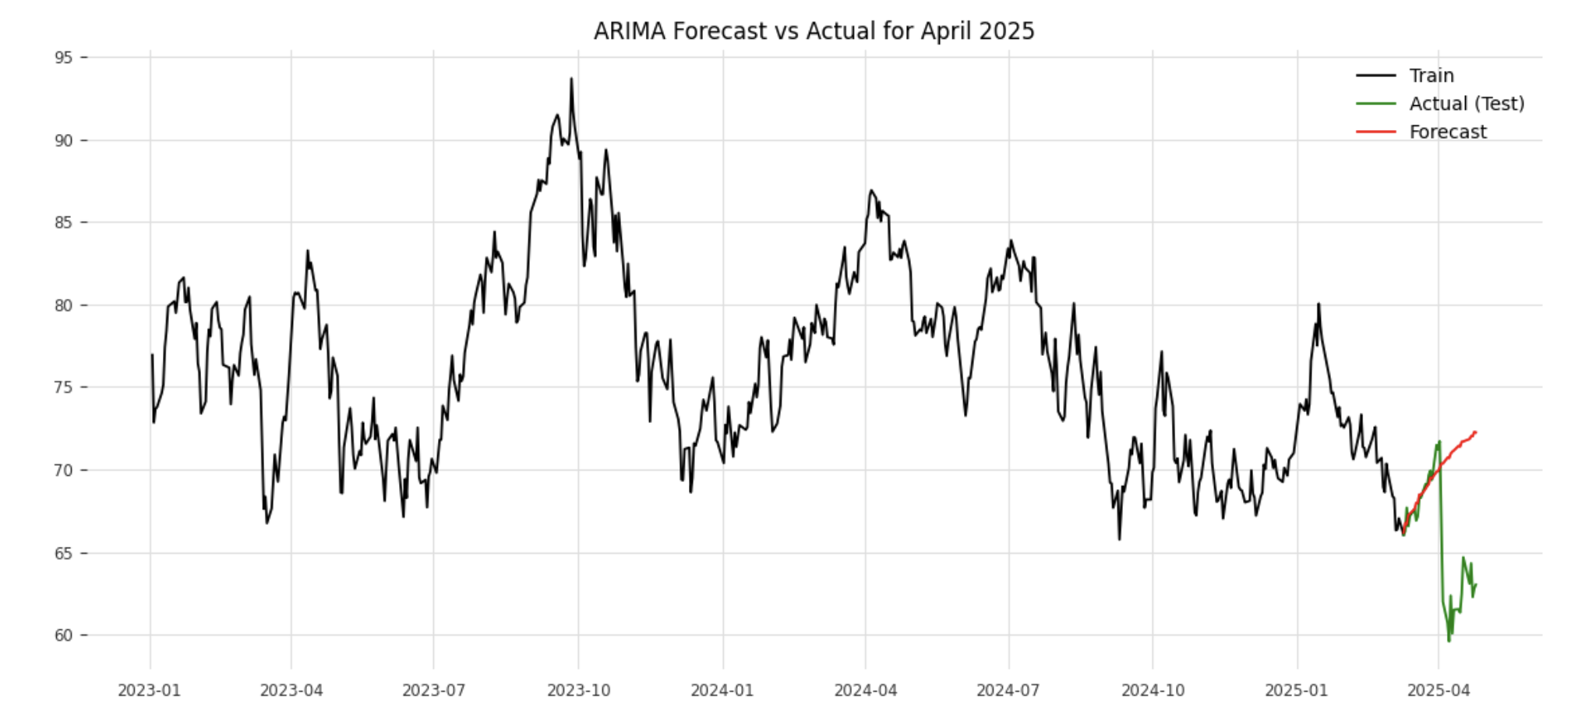
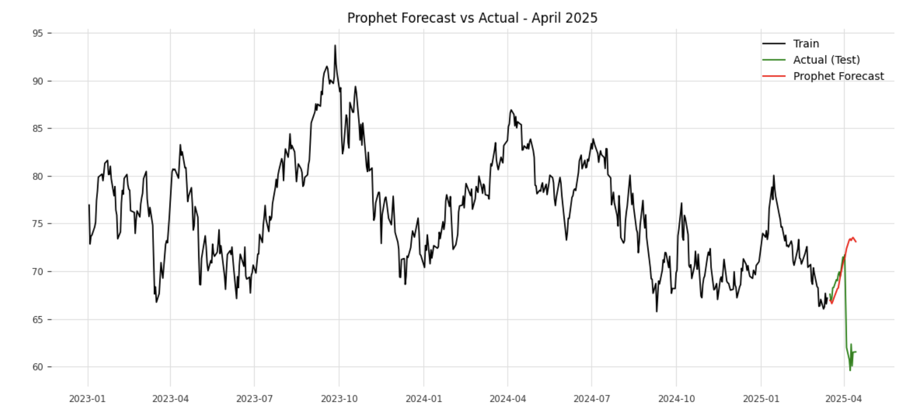
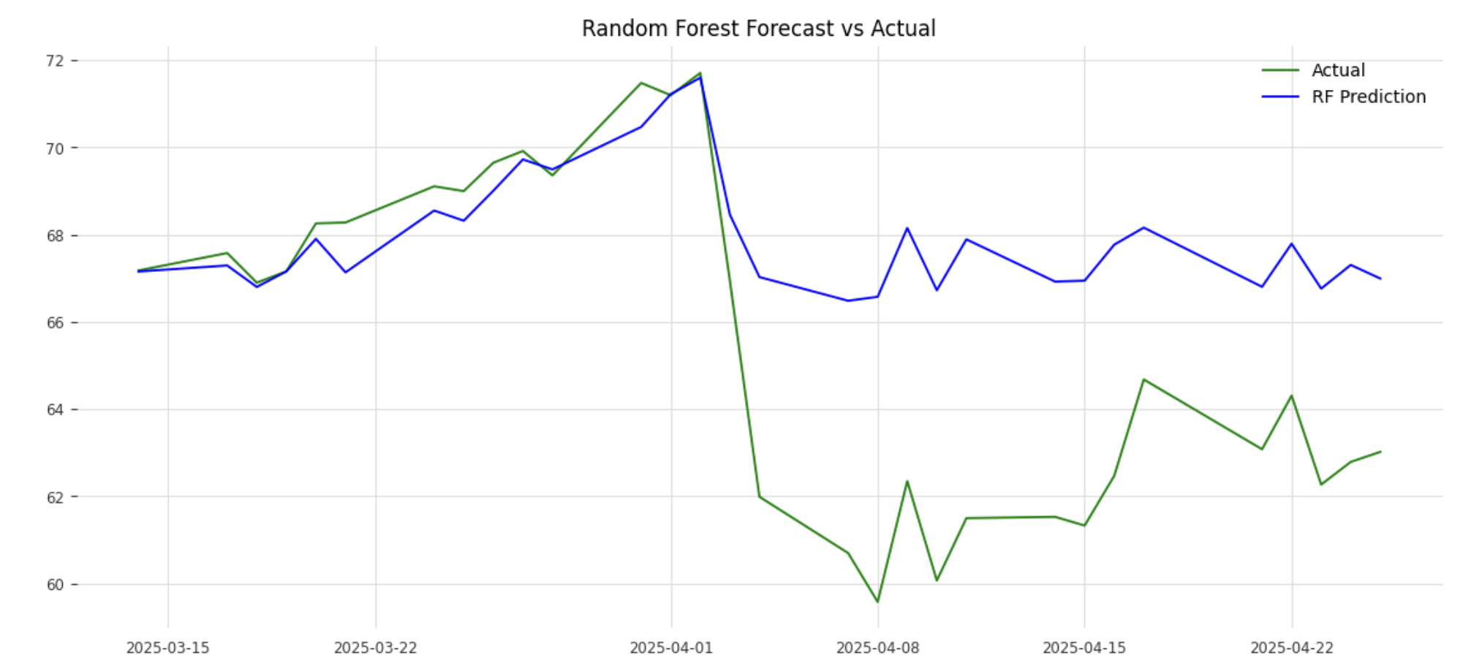
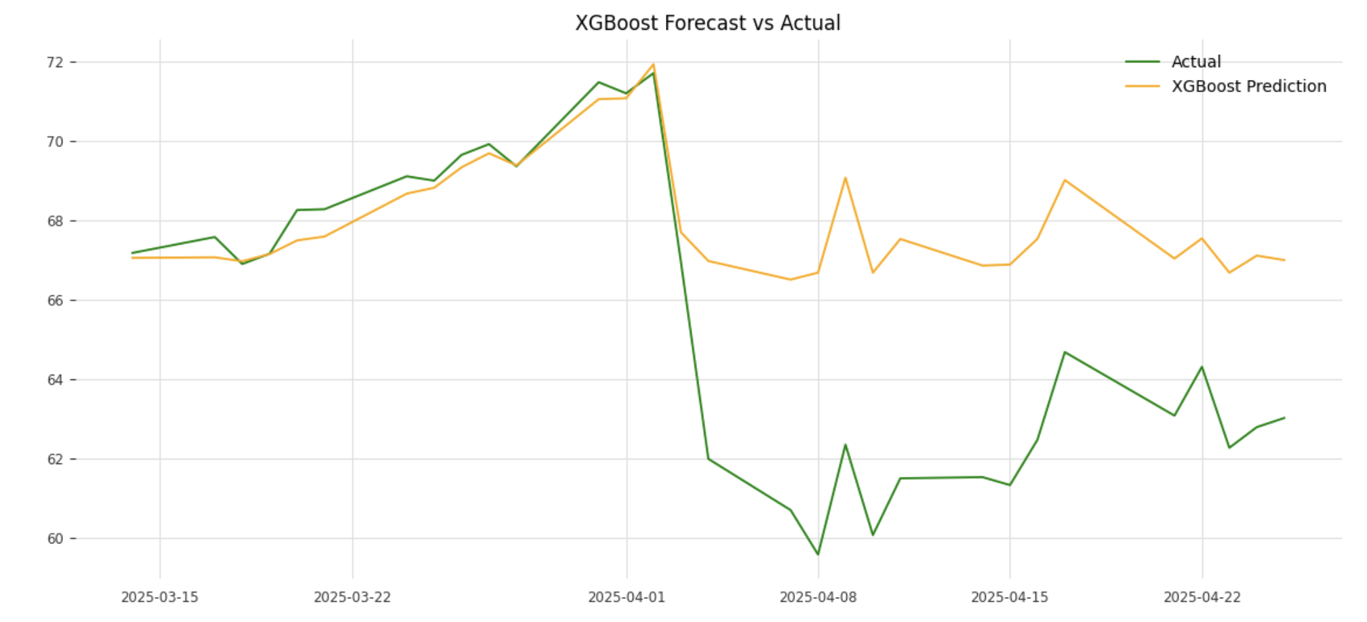
30 Days Prediction visualization

Slide 5
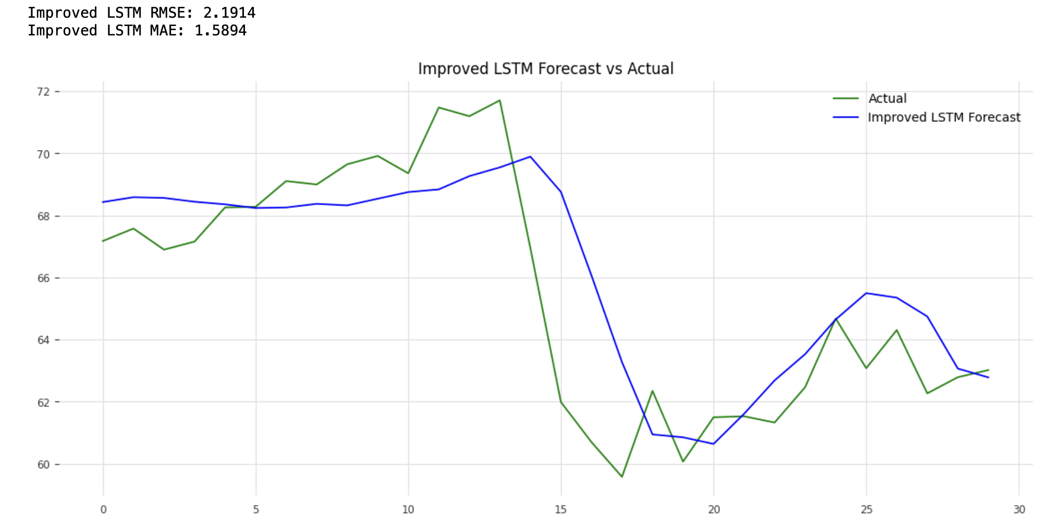
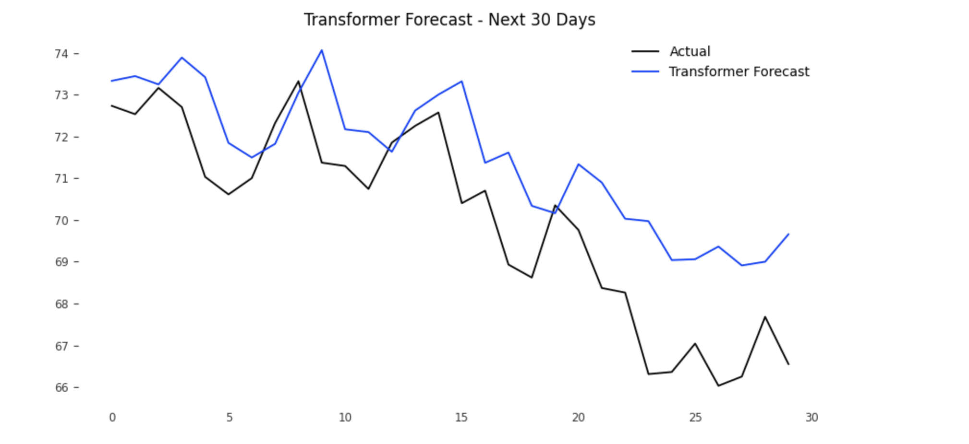
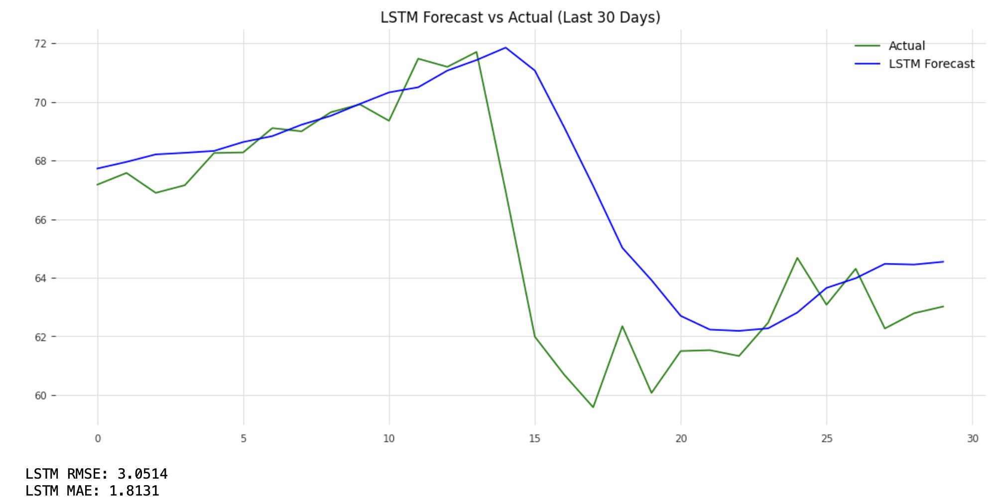

Slide 6
Features include price and news sentiment data
7-Day prediction Performance
Model 30 Days Prediction | RMSE | MAE
LSTM + News | 4.47 | 3.52
XGBoost + News | 3.91 | 2.59
Random Forest + News | 3.69 | 2.47
Transformer + News | 1.37 | 1.18
Model 7 Days Prediction | RMSE | MAE
XGBoost + News | 7.41 | 7.38
Random Forest + News | 4.85 | 4.80
LSTM + News | 4.21 | 3.48
Transformer + News | 3.15 | 2.96
🔹 Sentiment features hurt short-term (7-day) predictions across all models — especially for XGBoost and Random Forest, where RMSE spiked drastically, indicating that news sentiment introduced noise that overwhelmed meaningful short-term price patterns.
🔹 Transformer was the only model to benefit significantly from sentiment data. It improved its 30-day RMSE from 1.8790 ➔ 1.3795, showing that its global attention mechanism can extract valuable long-term macro signals from news data.
🔹 Deep learning models (LSTM variants) showed moderate degradation when sentiment was added, suggesting they were somewhat resilient to noise but unable to extract meaningful signal from sentiment for short horizons.
🔹 Overall, adding news sentiment is only beneficial for long-horizon forecasting with architectures like Transformers; for short-term forecasts, price-only features remain more reliable.

Slide 7
Key Takeaways about Transformers
🔹 Best Performer for Long-Term Forecasting (30 Days): The Transformer consistently delivered the lowest RMSE and MAE in 30-day price-only forecasting, outperforming all classical ML and deep learning models.
🔹 Significantly Improved with Sentiment Features: Unlike other models, the Transformer showed a clear boost when sentiment features were added — RMSE dropped from 1.8790 ➔ 1.3795, proving its strength in integrating unstructured signals like news.
🔹 Robust to Noisy Data in Long Horizons: While other models overfit or degrade with noisy sentiment inputs, the Transformer's attention mechanism enabled it to focus on relevant long-range signals and ignore short-term noise, especially useful for capturing macroeconomic trends.
🔹 Less Effective for Short-Term Forecasting (7 Days): For short horizons, the Transformer underperformed compared to Random Forest and LSTM. Its strength in modeling long-term dependencies becomes a drawback when only recent, local trends matter.

Slide 8
What I Learned from the Results
🔥 Deep learning (LSTM, Transformer) outperformed classical models
📈 News sentiment boosted 30-day forecasting accuracy for Transformer and degraded others
⚠️ News hurt 7-day short-term predictions for all algorithm except Transformer
🤖 AI predicts market reactions, not unknown future events
🧠 Short-term forecasting is easier than long-term prediction when ML Algorithms are used

Slide 9
Is AI the Future of Time Series Forecasting? 🚀
Classical models alone are no longer enough 📉
AI + External Data (like news) = new potential 🚀
But understanding context and market behavior is still critical 🧠
Curious to explore more? Let’s connect! 🤝

